Slide 1
CSE 108L Project
Introduction to Computer Science and Programming Using C Lab

Slide 2
Prepared and Submitted by:
Mohammad Ahmad Raza Khan – AP22110010453 (B.Tech CSE-G)
Harsh Singh – AP22110010455 (B.Tech CSE-G)
Khushi Malhotra – AP22110010450 (B.Tech CSE-G)
Gudapati Chetan Siddhartha – AP22110010432 (B.Tech CSE-G)

Slide 3
SGPA Reckoner for Educational Institutions
Objective
Introduction
Codes
Flowchart and Processing
Result
Advantages
Conclusion

Slide 4
Objective
The objective of this project was to implement all the theoretical knowledge, that we had acquired during the completion of our course (CSE 108) and to develop a program that calculates and prints the SGPA list (after calculating the relative grades) of the whole class using normal marks.

Slide 5
Introduction
This program is entirely designed and coded by our team without the involvement of any third-party, in C language.
The program prints a list containing Relative Grades and SGPA of n number of students of a class. The input includes the marks of n students in three subjects and the credits of each subject. It’s algorithm to perform relative grading in each subject, is based on the mathematical formula used by the premier institutes of our nation.
The program uses a number of functions to perform various tasks including calculations and printing of the result.

Slide 6
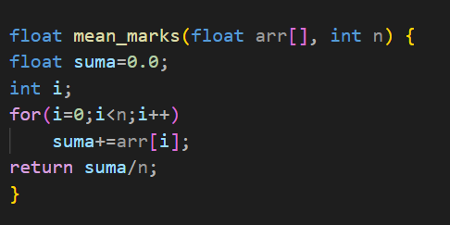
Codes
The program includes nearly 150 lines of codes including 5 user-defined functions, 4+ predefined-functions and a main class.
Here we have mentioned all the 5 user-defined functions and their operations:
float mean_marks(float [], int); // returns the mean marks of each subject.

Slide 7
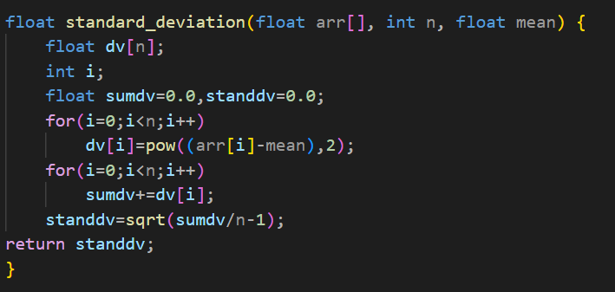
float standard_deviation(float [], int , float );
/* calculates and returns the standard deviation of the marks in a subject. */

Slide 8
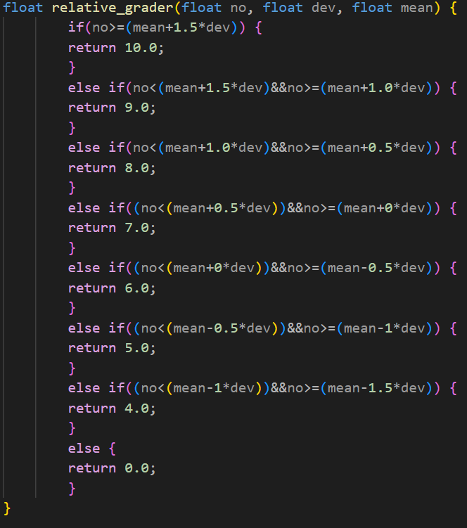
float relative_grader(float , float d, float );
/* calculates and returns the grade points in each subject for every student using relative-grading technique. */

Slide 9
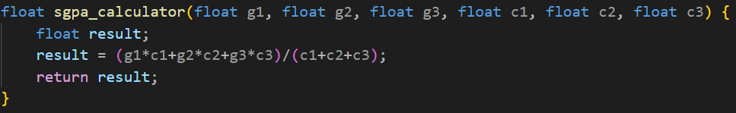
float sgpa_calculator(float , float , float , float , float , float );
/* computes and returns the SGPA for each student using relative grades and credits of three subjects. */

Slide 10
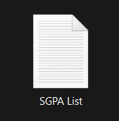
void textfile_writer(int , int [], float [], float [], float [], float [], float , float , float );
/* creates a text file using the principles and arithmetic of file handling in C Language. */
/* The file is stored in the storage of the computer device with the name “SGPA List.txt”.*/

Slide 11
Flowchart
Start
Input - Credits
Number of Students
Roll Numbers and Marks in 3 subjects
Mean Marks
Standard Deviation
A
A
Relative Grading
SGPA Calculations
Display of List
Text Writer
Stop

Slide 12
Processing
Input
Calculations
Number of students
Roll number of the i-th student
Class average in each subject
Standard Deviation of the marks in three subject.
Marks in subjects 1,2 and 3 of the i-th student
Relative Grades of the i-th student in each subject.
Output
Displaying of the list including Roll Number, Relative Grades in each subject and the SGPA of each student along with the class average in each course.
The complete list in the form of a .txt file titled “SGPA List,” can be found in the storage of the computer system.
SGPA of each student using Relative Grades and Credits of each subject.

Slide 13
The program, Input and the Result

Slide 14
Advantages
Convenient to use.
Helps in calculating grade points and SGPA of n number of students by using their normal marks.
Time saving.
Accurate.
Helps in the maintenance of record by saving the result in the form of a text file.
No prior knowledge of CS required to operate.
Provides systematic output.

Slide 15

Conclusion
This successful project was completed and submitted in the partial fulfilment for the award of Degree: Bachelors of Technology in Computer Science Engineering.
This project widely contributed in the development and expertise of our skills, such as communication, presentation, team-working and problem solving to list a few.
We have successfully implemented various concepts and components of C Language that were taught to us in the course - CSE 108.
We sincerely thank Prof. Deepthi KC for her guidance and encouragement in carrying out this project work.

Slide 16
<h1> Thank you! &#128513; </h1>

